Slide 1

IOT BASED PILL DISPENSER BATCH - 22
Project Member Details:
PRABHALA NEHA - RA2211053010025
PERI SRI VIDYA - RA2211053010043
ISHITA MISRA - RA2211053010058
Project Guide:
DR. A.V.M. MANIKANDAN

Slide 2
Introduction
One of the biggest problems in the health care industry is medication adherence.
Often elderly people fail to take their medication on time and for elders with more than one medication, the chances of overdosing are considerably high.
This could easily lead to catastrophic events such as permanent disability or even death.
Hence, it is evident that it is a widespread problem and needs a solution. To address this, the IOT based pill dispenser has been designed.

Slide 3
Motivation & Objectives of the work
Motivation:
The main idea of an IoT-based pill dispenser is to help people take their medicines on time and in the right amount. It is especially useful for elderly people or those who forget their medications. This device uses technology to make medicine management easy and reliable.
Objectives:
1. Helping People Take Medicines on Time: Reminds patients to take the correct dose at the right time.
2. Allowing Caregivers to Check: Caregivers can monitor medicine schedules from anywhere.
3. Avoiding Mistakes: Prevents errors like missing a dose or taking the wrong amount.
4. Encouraging Independence: Helps users manage their medication without much help.
5. Adding Extra Health Features: Some dispensers also monitor health, like checking heart rate or other vital signs.

Slide 4
Literature Review
Serial Number | Author, Journal and Year | Title | Inference
1. | Kumar et al. (2021) Journal of Microelectronics and SolidState Devices | Smart Pill Dispenser using Raspberry Pi and Cloud Technology | Achieved 95% accuracy in dispensing pills and provided real-time alerts to caregivers. Demonstrated the importance of remote patient monitoring and cloud data storage for healthcare management.
2. | Lee et al. (2022) Healthcare Technologies | AI-Based Pill Dispenser for Medication Adherence | Used machine learning to analyze medication intake patterns and predict missed doses, improving medication adherence by 20%. Highlighted AI’s role in healthcare.
3. | Smith et al. (2020) Asian Journal Of Science and Applied Technology | Blockchain-Based Secure Pill Dispenser | Implemented blockchain for secure sharing of patient data between patients, caregivers, and doctors, ensuring privacy and data security.
4 | World Health Organization (WHO, 2019) World Health Organization Report | IoT-Based Solutions for Medication Non-Adherence | Reported global medication non-adherence issues and recommended IoT-based pill dispensers to improve adherence and health outcomes.

Slide 5
Problem Statement
Medication non-adherence is a critical issue, particularly for elderly individuals and patients with memory challenges, leading to missed doses, incorrect intake, and poor health outcomes.
Current methods of managing medications are prone to human error and lack the ability for caregivers to monitor remotely.
There is an urgent need for a smart, automated solution that ensures timely medication reminders, accurate dispensing, and remote monitoring to improve adherence and support better healthcare management.

Slide 6
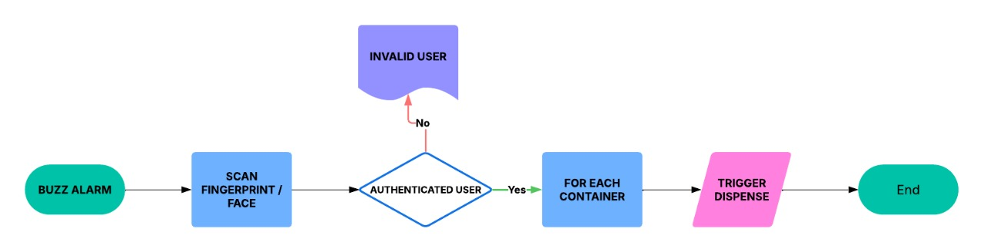
Block Diagram

Slide 7
Block Diagram
1.System Alert : Buzzer activates for medication reminder; IoT sends mobile app alerts.
2.User Authentication: User scans fingerprint; system verifies against stored data.
3.Authentication Check: If valid, proceed; if invalid, display "Access Denied."
4.Identify Medicine: System checks schedule and selects the correct pill compartment.
5.Dispense Medication: Servo motors release pills; IR sensor detects if pills are taken.
6.Process Completion: Logs event in memory/cloud, sends confirmation, and resets for the next dose.

Slide 8
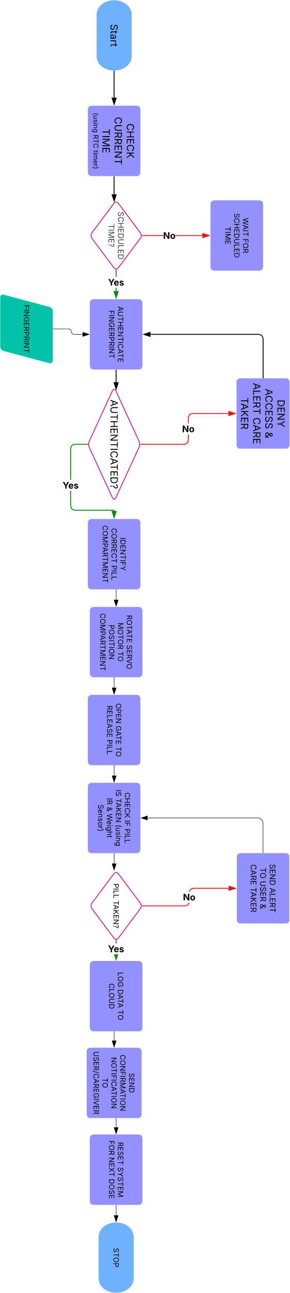
Dispenser Block Diagram

Slide 9
Engineering Standards & Realistic Constraints
Engineering Standards:
1. IoT Standards:
- Following IoT communication standards like ISO/IEC 30141 for security and reliability.
- Using IEEE 802.11 for wireless communication and ISO/IEC 27001 for data security.
2. Healthcare Standards:
- Comply with ISO 13485 for safe and effective medical devices.
- Adhere to regional medical regulations (e.g., FDA in the US).
3. Electrical and Software Standards:
- Follow IEC 60601 for electrical safety.
- Ensure non-toxic materials through RoHS compliance.
- Use software guidelines like ISO/IEC 25010 for quality and IEEE 29119 for testing.

Slide 10
Engineering Standards & Realistic Constraints
Realistic Constraints:
1. Technical: The device must have minimal power consumption to ensure prolonged operation, with options for battery backup in case of power failure. It should support wireless connectivity (e.g., Wi-Fi, Bluetooth) for seamless integration with mobile apps and healthcare databases. The dispenser must be durable, capable of withstanding regular use by elderly individuals, and ensure accurate and timely medicine dispensing with fail-safe mechanisms to prevent overdosing or missed doses.
2. Design: The dispenser must be ergonomically designed for ease of use by elderly individuals, featuring a simple and intuitive interface with large buttons, and clear labeling. The refilling mechanism should be straightforward, allowing caregivers or users to load medicines without difficulty.
3. Economic: The device must be cost-effective, ensuring affordability for users while keeping manufacturing and maintenance costs low. This includes using readily available, low-cost electronic components without compromising reliability.

Slide 11
Tools Used
IoT Connectivity – The device connects to the internet and syncs with smartphones, tablets, or caregiver systems for real-time monitoring and alerts.
Automated Dispenser – It stores and dispenses the right dose of medicine at scheduled times.
LED Display and Voice Alerts – These features ensure users receive visual and auditory reminders to take their medication.
Sensors and Monitoring System – Tracks whether the patient has taken the medication and records adherence data.
Heart Rate & Blood Pressure Sensors: Monitors the patient’s vitals to assess their response to medications. These are useful for patients with hypertension, cardiac conditions, or diabetes.
Temperature Sensors: Monitors storage conditions to ensure medications are kept at the correct temperature, especially for heat-sensitive drugs.
Mobile App Integration – Caregivers and family members can monitor the patient’s medication schedule remotely.
Emergency Alert System – If the user forgets to take the medicine, the device can send alerts to designated contacts

Slide 12
Results(If any)

Slide 13
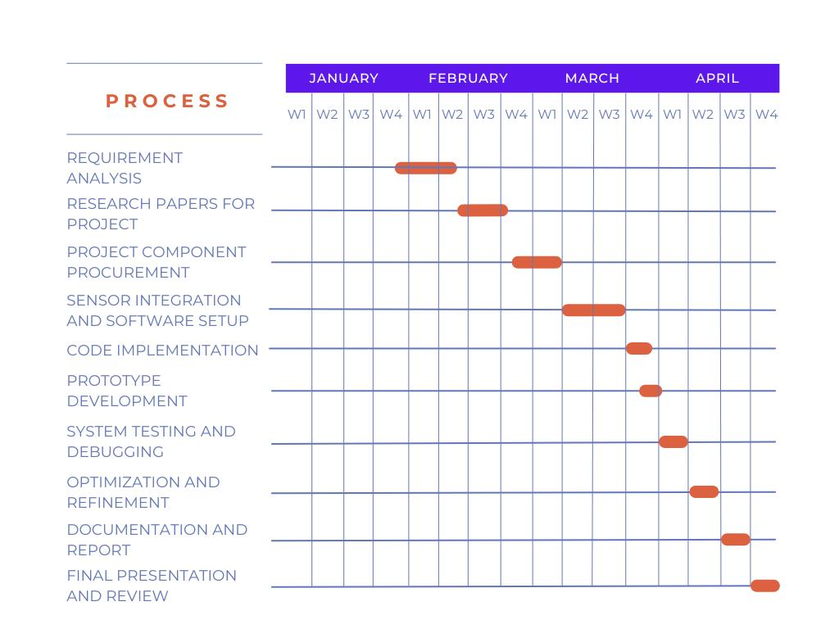
Time & Action Plan (Gantt Chart)

Slide 14
References
1. K. Raj, J. Nisha, and N. Prabhakaran, "Automated Low-Cost Pill Dispenser Using Arduino and IoT with 24 Hours Monitoring," International Research Journal of Modern Engineering and Technology , vol. 3, no. 8, pp. 1-10, Aug. 2021. Available: [IRJMETS](https://www.irjmets.com/uploadedfiles/paper/volume_3/issue_8_august_2021/15468/final/fin_irjmets1628414571.pdf).
2. G. Krishna, J. Sri, K. R., and K. Nithya, "An IoT-Based Smart Pill Dispenser with Health Monitoring," International Research Journal of Engineering and Technology, vol. 10, no. 10, pp. 1-8, Oct. 2023. Available: [IRJET](https://www.irjet.net/archives/V10/i10/IRJET-V10I10130.pdf).
3. P. Dayananda and A. G. Upadhya, "Development of Smart Pill Expert System Based on IoT," Journal of The Institution of Engineers (India): Series B, vol. 105, pp. 457–467, Feb. 2024. Available: [Springer](https://link.springer.com/article/10.1007/s40031-023-00956-2).
4. S. Agnihotri, D. Singh, A. Kumar, M. Gupta, and S. Gautam, "IoT-Based Pill Dispenser System," Journal of Microelectronics and SolidState Devices, vol. 11, no. 1, pp. 18-24, Jun. 2024.
5. F. Ramapur, C. Shanbog, D. Kulkarni, and F. Jakati, "Smart Medication Dispenser and Reminder Using Embedded System," KSCST Project Reference No. 47S_BE_4452, K.L.S. Vishwanathrao Deshpande Institute of Technology, Haliyal, India, 2023.
6. A. Sharma and R. Verma, "IoT-Based Healthcare Solutions: A Comprehensive Review," IEEE Access, vol. 9, pp. 12345-12360, 2023.
7. M. Patel, S. Desai, and K. Shah, "Smart Pill Box with IoT Integration for Medication Adherence," International Journal of Advanced Research in Computer Science, vol. 12, no. 4, pp. 45-50, 2023.
8. T. Nguyen and H. Tran, "IoT-Enabled Medication Dispenser for Elderly Care," Journal of Healthcare Engineering, vol. 2023, Article ID 123456, pp. 1-10, 2023.
9. R. Gupta, P. Mehta, and S. Kapoor, "Design and Implementation of IoT-Based Smart Pill Dispenser," International Journal of Electronics and Communication Engineering, vol. 15, no. 2, pp. 89-95, 2023.
10. L. Wang, X. Li, and Y. Zhang, "IoT in Healthcare: Smart Pill Dispenser Systems," IEEE Transactions on Biomedical Engineering, vol. 70, no. 1, pp. 12-20, 2024.

